Slide 1

CE327 - Digital VLSI Systems
Semester Project part B Presentation
Fall Semester - 2022
Ioanna-Maria Panagou
2962

Slide 2
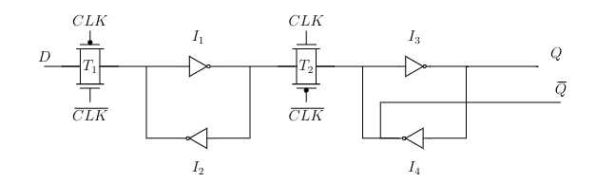
DFF Mistakes
Use of polysilicon gate for wiring (large internal capacitances)
Omission of n- and p- wells and substrate contacts (latch-up phenomenon)
Inverter for Qbar (extra, redundant logic)

Slide 3
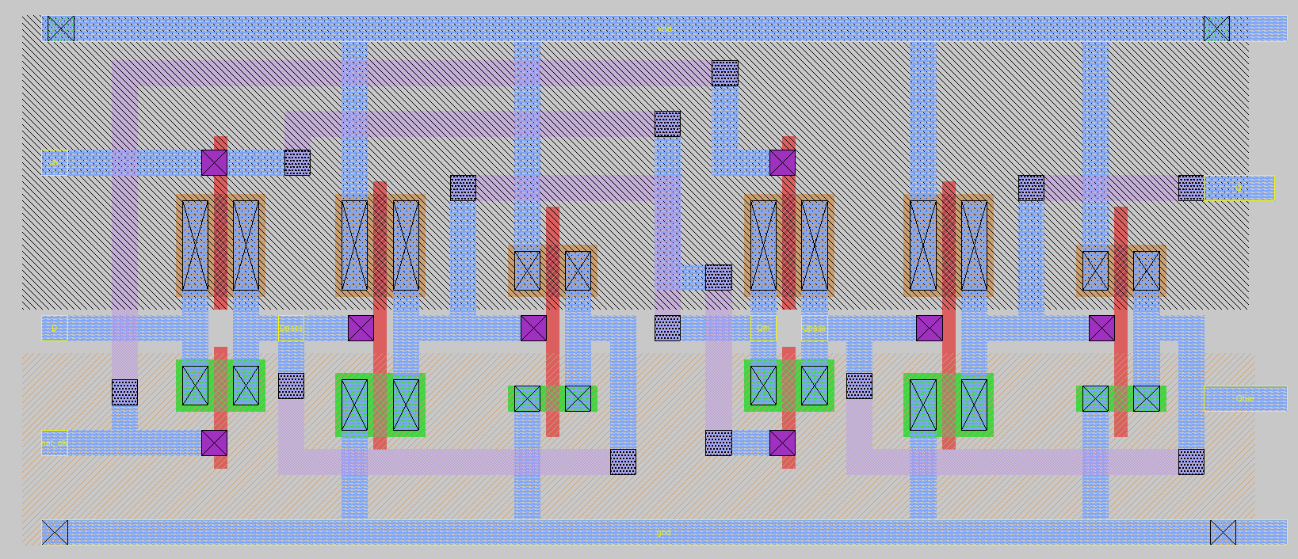
New DFF Layout

Slide 4
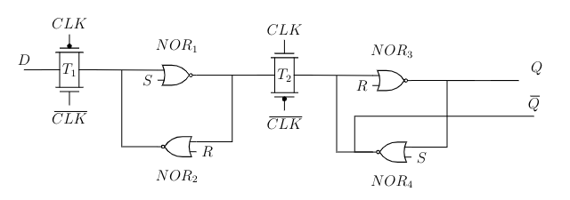
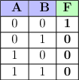
DFFRS Mistakes
The same mistakes of the DFF also apply to our DFFRS implementation
Also, our design was cumbersome and carried a lot of extra logic

Slide 5
Configuration File Format
{
cell: {
path: <path to extracted .spice file>
type: “combinational” or “sequential”
pins: {
pin name: {
direction: “input” or “output”
function:
timings: {
timing: {
related_pin:
when:
timing_sense:
timing_type:
measurements: <list of timing or constraint arcs>
}
}
}
}
}
}
ff (“IQ”, “IQN”) {
next_state:
clocked_on:
preset:
clear:
}

Slide 6
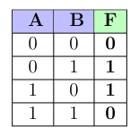
XOR Timing Arcs
Only the output pin has timing arcs
A when !B
positive unate
A when B
negative unate
B when A!
positive unate
B when A
negative unate

Slide 7
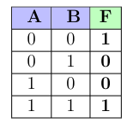
XNOR Timing Arcs
Only the output pin has timing arcs
A when !B
negative unate
A when B
positive unate
B when A!
negative unate
B when A
positive unate

Slide 8
DFF Timing and Constraint Arcs
Timing arcs
CLK-to-Q and CLK-to-Qbar with timing type equal to “rising_edge”, because the DFF is positive-triggered (cell_rise and cell_fall)
Rise and fall delays of Q and Qbar (rise_transition and fall_transition)
Constraint arcs
Timing types “setup_rising” and “hold_rising” (D with respect to CLK). We need to measure both rise and fall constraints

Slide 9
DFFRS Timing and Constraint Arcs
The same timing and constraint arcs with relation to CLK as the DFF. Additional arcs include:
Timing arcs
Q and Qbar with respect to S and R. Since S is active-high, it has a positive_unate timing sense for Q and negative for Qbar. R is again active-high, so negative_unate timing sense for Q and positive_unate sense for Qbar. Also, we must test those timing arcs for every possible combination of the side inputs CLK, D and R/S.
Constraint arcs
We need to measure recovery and removal time of the asynchronous inputs S and R with respect to CLK (analogous to setup and hold).

Slide 10
Methodology
Cell rise: Low-to-high propagation delay, time difference between the related pin reaching the 50% of its final value on its rising or falling slope, as defined by the unateness of the timing arc and the pin reaching the 50% of its final value on its rising slope.
Cell fall: High-to-low propagation delay, time difference between the related pin reaching the 50% of its final value on its rising or falling slope and the pin reaching the 50% of its final value on its falling slope.
Rise transition: We measure the time between the pin reaching the 30% and 70% of its final value on a rising slope.
Fall transition: We measure the time between the pin reaching the 30% and 70% of its final value on a falling slope.

Slide 11
Methodology
Rise constraint: How close relatively to the active clock edge the pin can rise without violating the setup, hold, removal and recovery constraints.
Fall constraint: How close relatively to the active clock edge the pin can fall without violating the setup, hold, removal and recovery constraints.

Slide 12
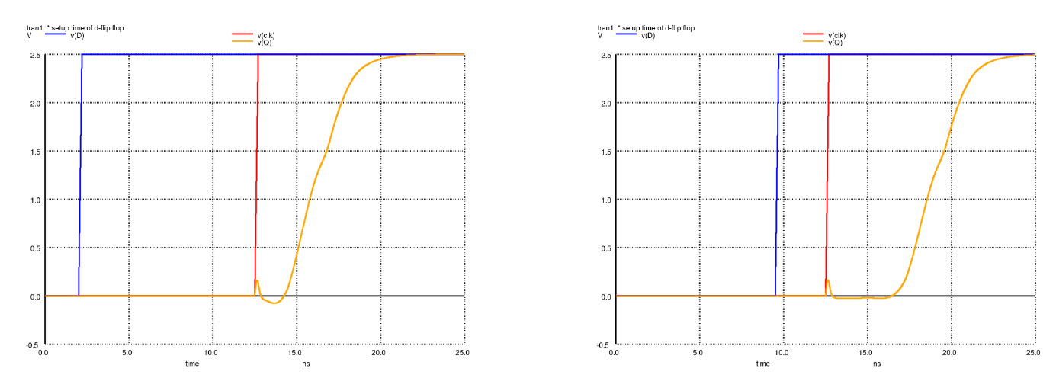
Methodology
Setup: the time difference between the last change of input D before the active edge of the clock and the arrival of this edge, so that the CLK→Q delay is 1.05 greater than the CLK→Q, if there was no setup violation

Slide 13
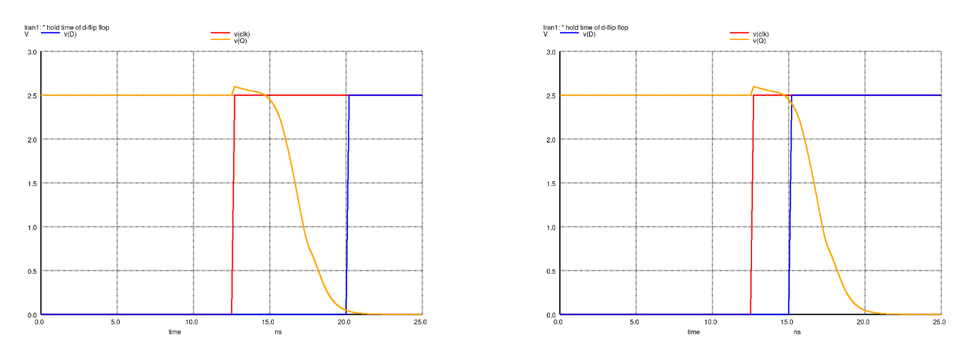
Methodology
Hold: the time difference between the last change of input D after the active edge of the clock and the arrival of this edge, so that the CLK→Q delay is 1.05 greater than the CLK→Q, if there was no hold violation

Slide 14
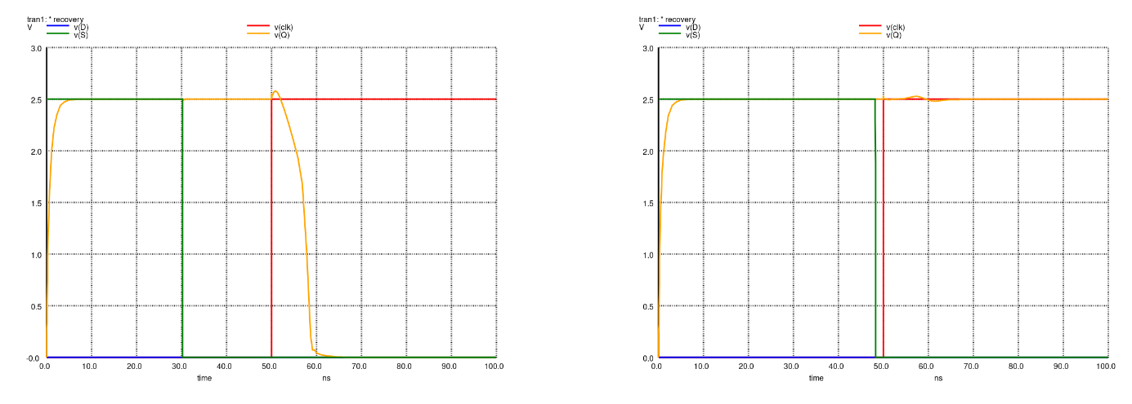
Methodology
Recovery: the minimum time between the deactivation of the asynchronous inputs R and S and the active edge of the clock, so that the cell still functions properly.

Slide 15
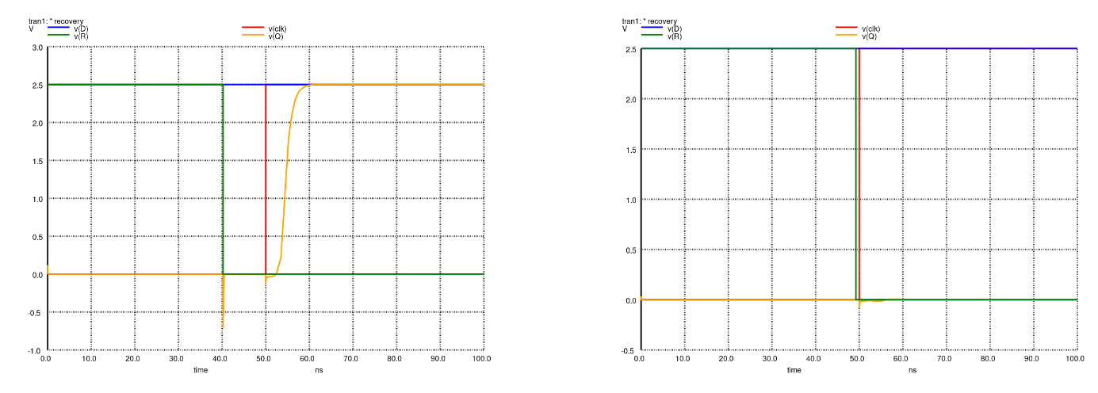
Methodology
Recovery: the minimum time between the deactivation of the asynchronous inputs R and S and the active edge of the clock, so that the cell still functions properly.

Slide 16
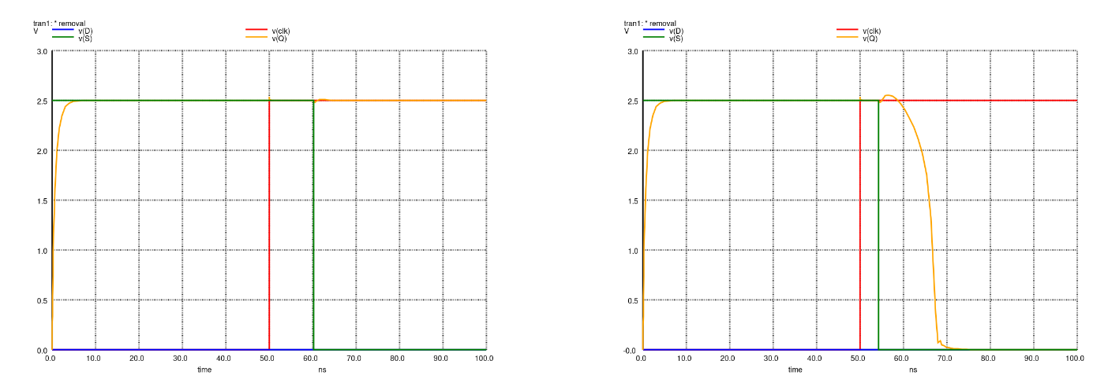
Methodology
Removal: the minimum time between the deactivation of the asynchronous inputs R and S (after the clock edge) and the active edge of the clock, so that the cell still functions properly.

Slide 17
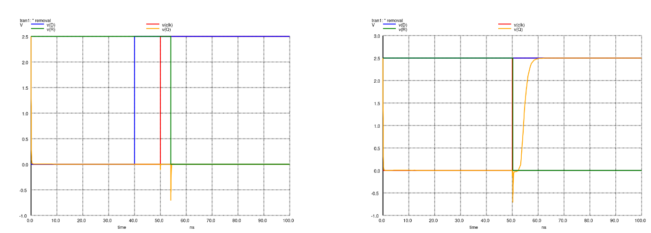
Methodology
Removal: the minimum time between the deactivation of the asynchronous inputs R and S (after the clock edge) and the active edge of the clock, so that the cell still functions properly.

Slide 18
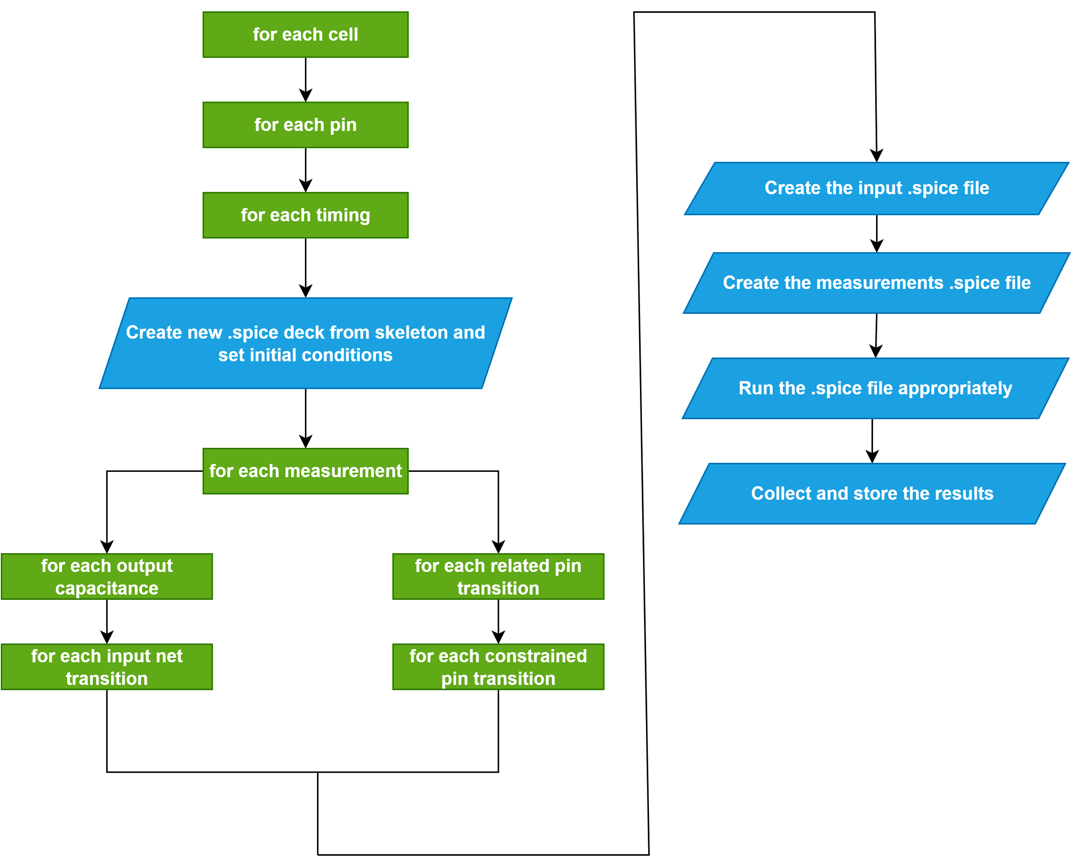
Static Analysis Timing Flow

Slide 19
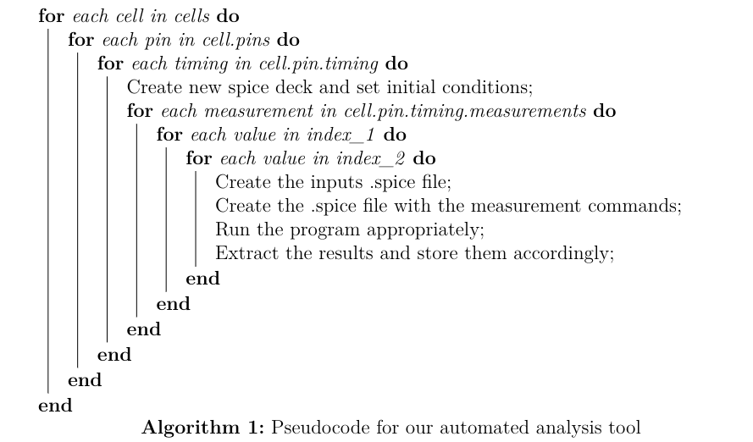
Static Analysis Timing Flow

Slide 20
Static Analysis Timing Flow

Slide 21
New spice deck and initialization
3 skeletons: combinational.spice, dff.spice, dffrs.spice
Include the paths to the .spice files extracted from Magic
Include the input and measurement files
Instantiate the cell as a subcircuit
Instantiate the total output capacitances
Declare the initial output voltages, using the .ic command
Indicate the type, duration and time step of the analysis
Contain a control segment with just the run command

Slide 22
New spice deck and initialization
3 skeletons: combinational.spice, dff.spice, dffrs.spice
Include the paths to the .spice files extracted from Magic
Include the input and measurement files
Instantiate the cell as a subcircuit
Instantiate the total output capacitances
Declare the initial output voltages, using the .ic command
Indicate the type, duration and time step of the analysis
Contain a control segment with just the run command

Slide 23
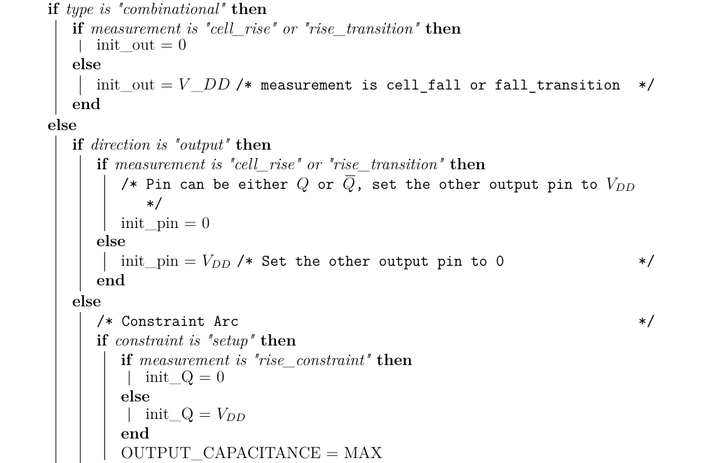
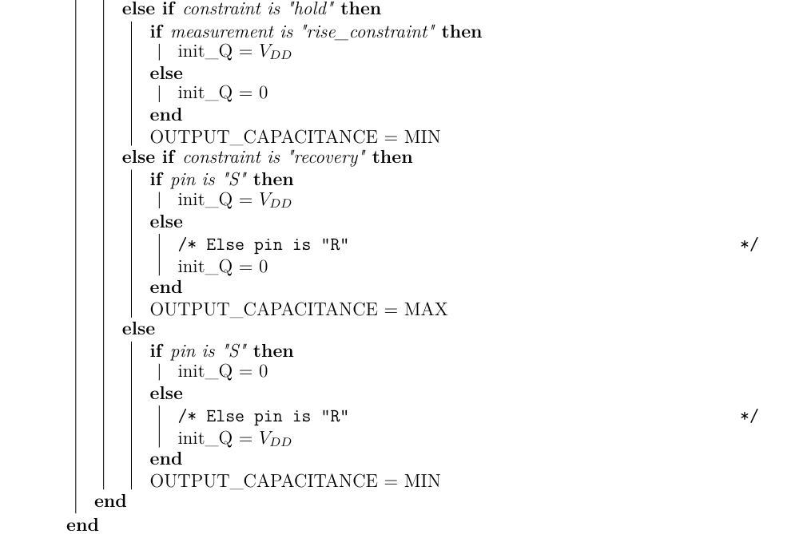
New spice deck and initialization

Slide 24
Static Analysis Timing Flow

Slide 25
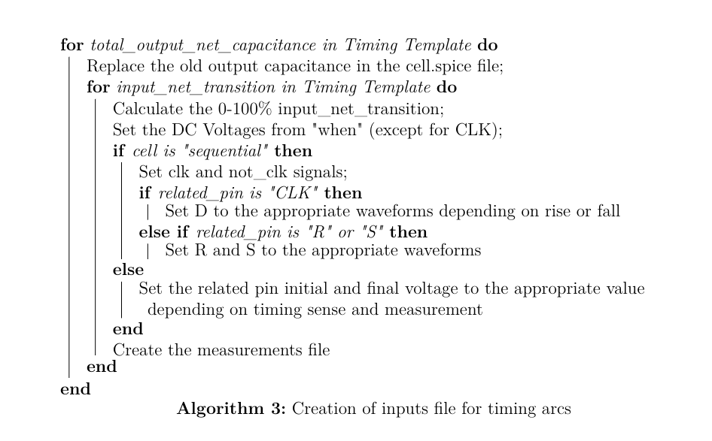
Creating the inputs file (timing arcs)

Slide 26
Creating the inputs file (timing arcs)

Slide 27
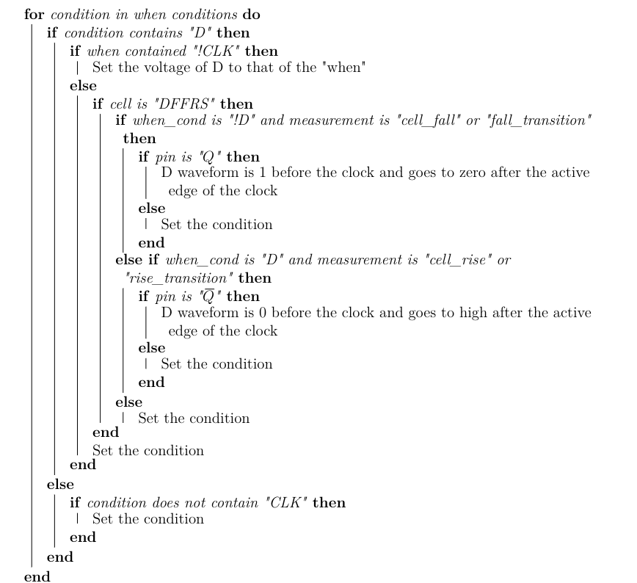
Creating the inputs file (timing arcs)

Slide 28
Creating the inputs file (timing arcs)

Slide 29
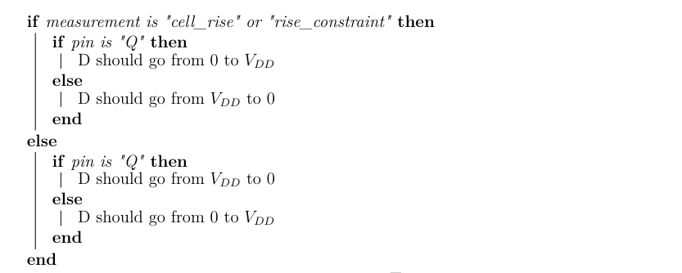
Creating the inputs file (timing arcs)

Slide 30
Creating the inputs file (timing arcs)

Slide 31
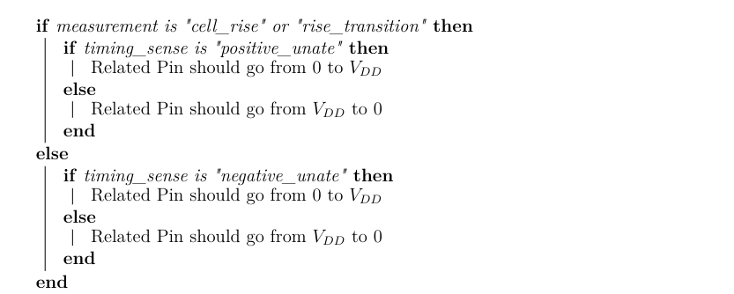
Creating the inputs file (timing arcs)

Slide 32
Creating the inputs file (timing arcs)

Slide 33
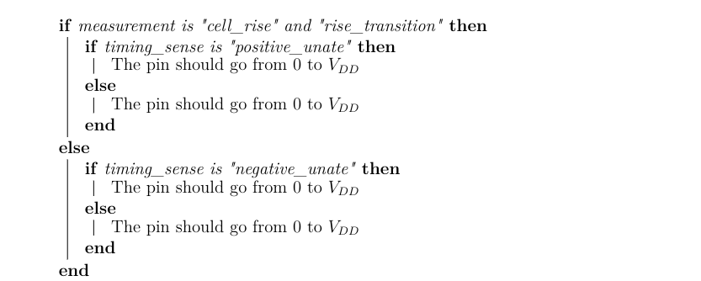
Creating the inputs file (timing arcs)

Slide 34
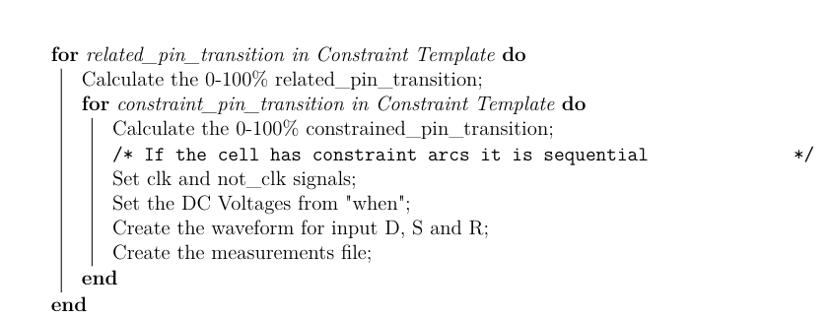
Creating the inputs file (constraint arcs)

Slide 35
Creating the inputs file (constraint arcs)

Slide 36
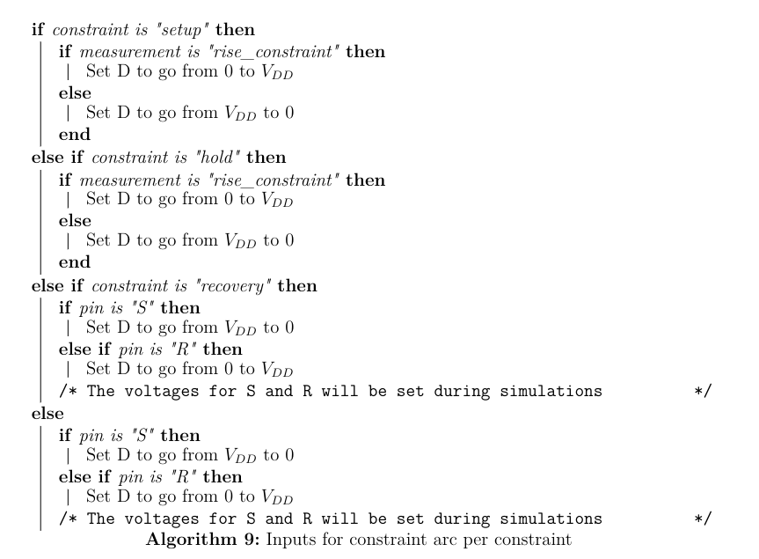
Creating the inputs file (constraint arcs)

Slide 37
Static Analysis Timing Flow

Slide 38
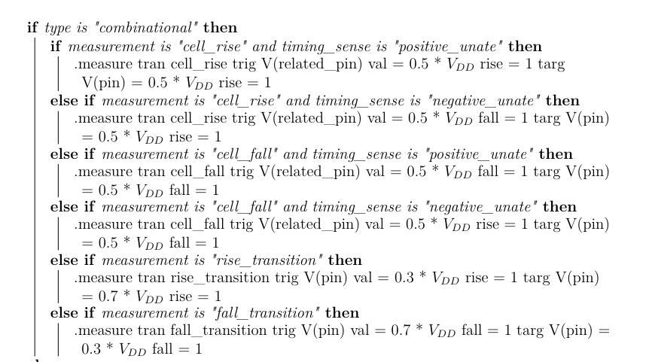
Creating the measurements file (timing arcs)

Slide 39
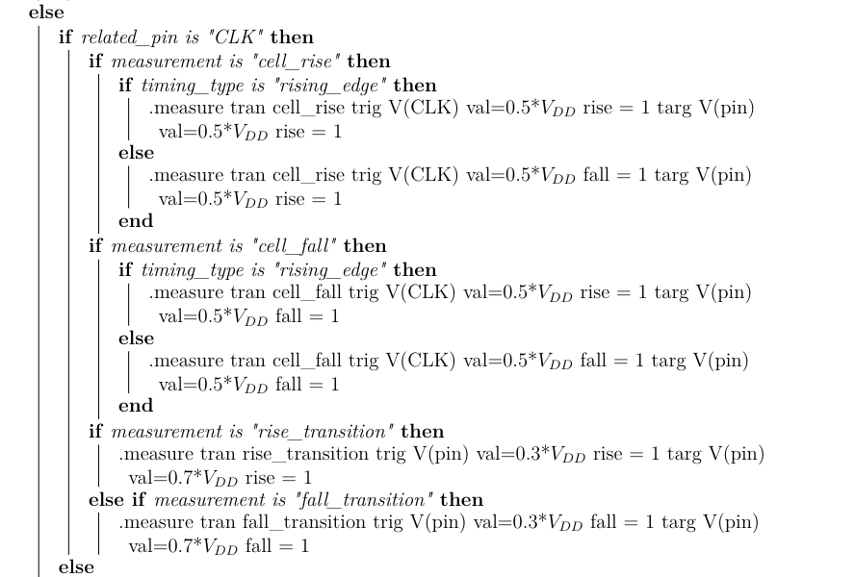
Creating the measurements file (timing arcs)

Slide 40
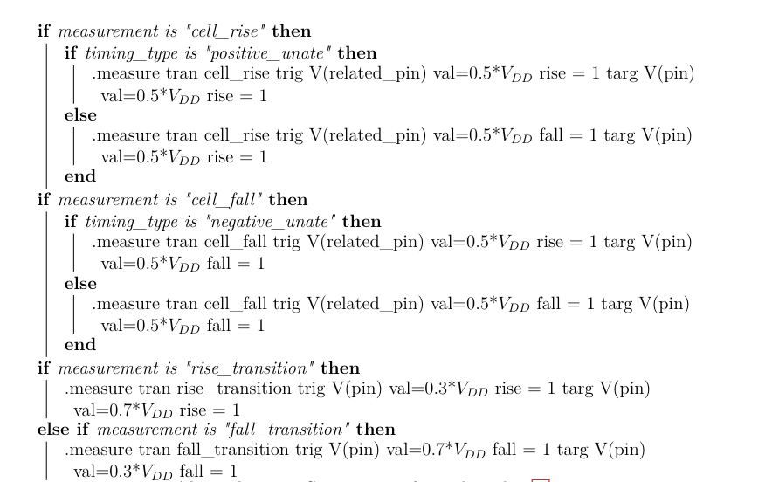
Creating the measurements file (timing arcs)

Slide 41
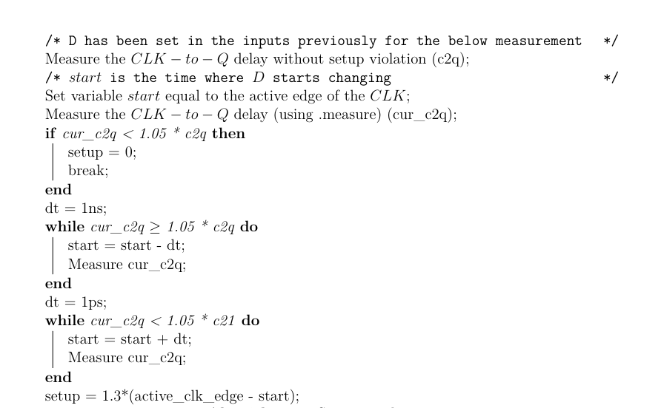
Creating the measurements file (setup)

Slide 42
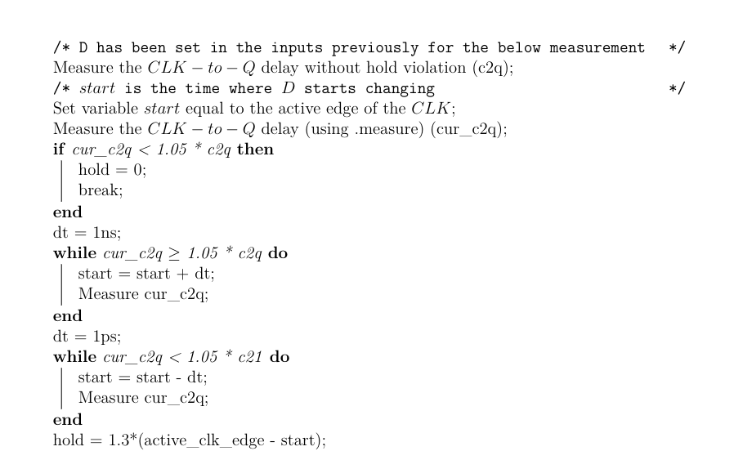
Creating the measurements file (hold)

Slide 43
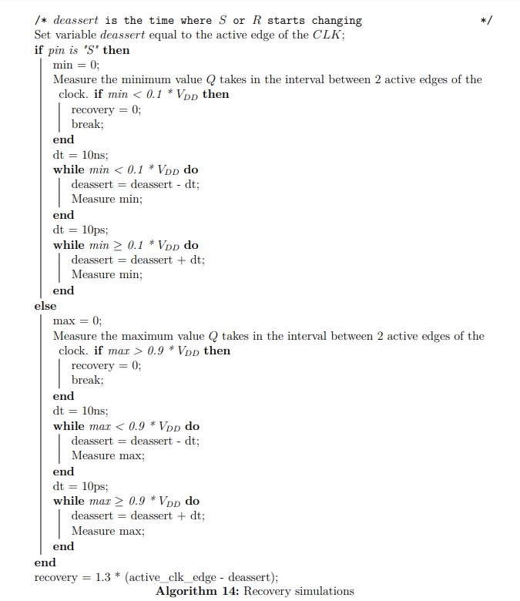
Creating the measurements file (recovery)

Slide 44
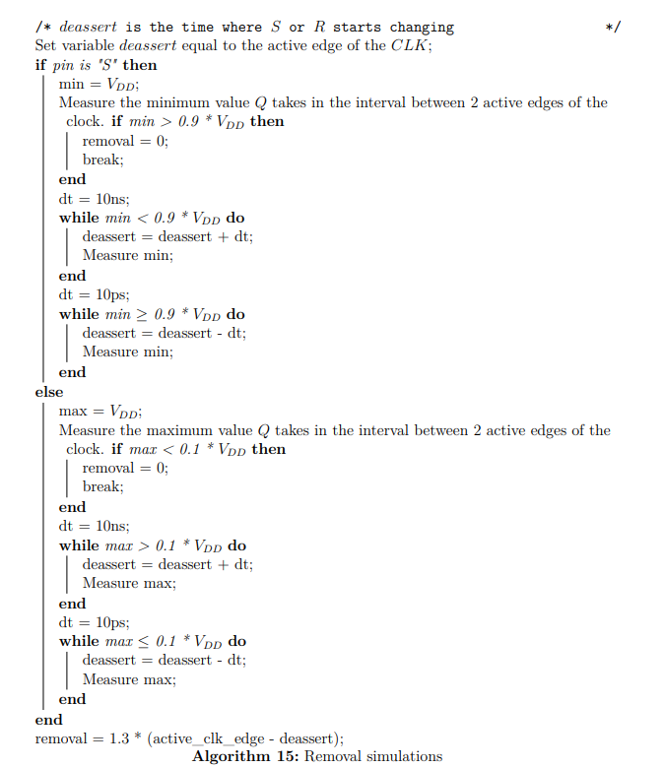
Creating the measurements file (removal)

Slide 45
Observations
The propagation delay and rise and fall delays are greater as the total output net capacitance and input net transition increase
For both the DFF and the DFFRS, the hold time is 0.
The recovery time is mostly 0 for the DFFRS, except for the cases where the constrained pin transition is the maximum and the removal time is mostly non-zero except for the case, where, again, the constrained pin transition is the maximum.

Slide 46
Verilog Modules
The creation of verilog modules for the cells in our library involved creating the primitives and the specify blocks
The specify blocks were created by a nested loop that connected every input with an output.
The primitives for the combinational cells were easy; we just had to evaluate (using the eval python function), the function associated with the output for every input combination.

Slide 47
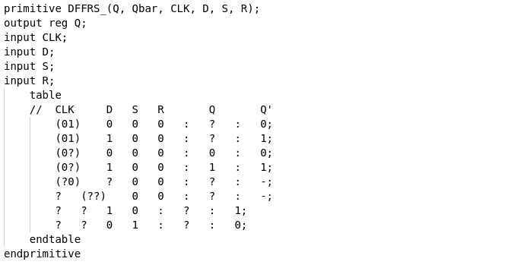
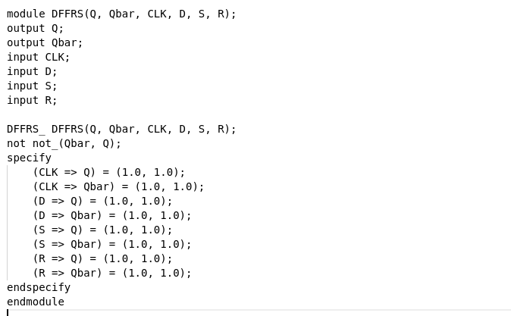
Verilog Modules
For the sequential cells, we had to be more cautious, because we had to identify the active clock edge and whether S and R are active low or active high.

